Slide 1
Formative Assessment of Availability of Healthy Snacks & Beverages in Stores near Schools in Two Rural Oregon Counties Nancy Findholt, PhD, RN Associate Professor
Contact info: findholt@ohsu.edu
Oregon Public Health Association
Annual Conference
October 12, 2015

Slide 2
Rural children are at greater risk for obesity than their urban counterparts
Differences in healthy food access may contribute to this disparity

Slide 3
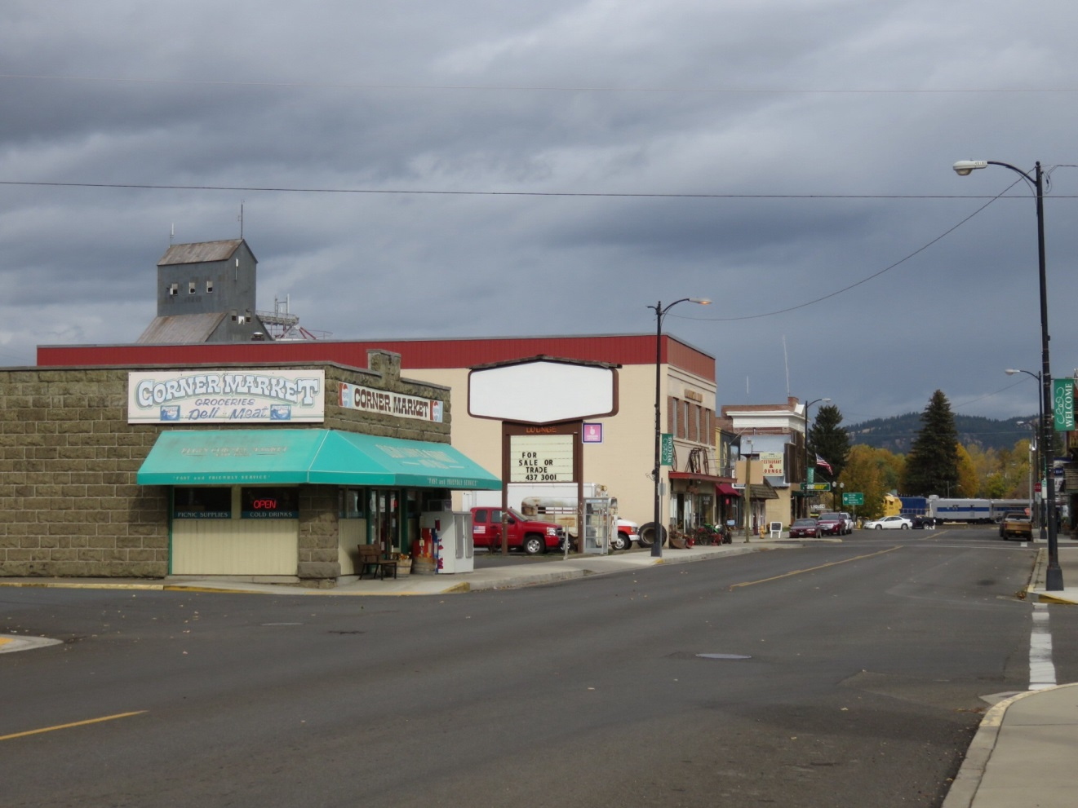
Children often buy snacks & beverages at food stores
near their
schools

Slide 4
PURPOSES
Obtain baseline data on availability of healthy snacks & beverages in stores near rural schools
Understand store owner perspectives on stocking these items

Slide 5
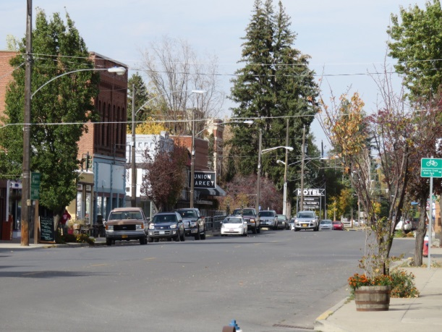
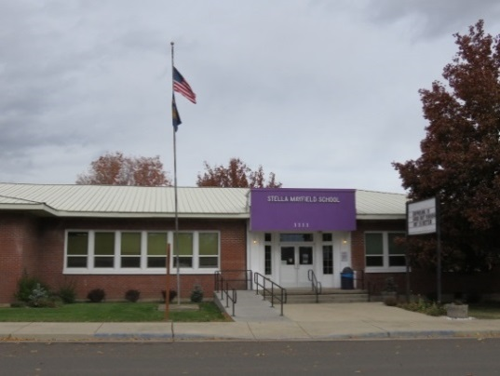
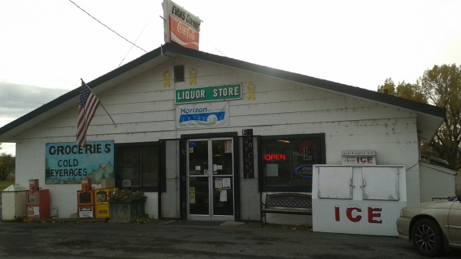
SETTING & SAMPLE
Eight small communities (<2000 residents each) in Union & Wallowa counties
Each community has at least one food store within ½ mile of the schools (15 total stores)
5 grocery stores
6 convenience stores
4 gas station food marts

Slide 6
METHODS
Healthy snack & beverage availability:
SNACZ Food Store Checklist
Frequency distributions computed for each item
Store owner perspectives:
Semi-structured interviews
Transcripts analyzed using thematic analysis

Slide 7
AVAILABILITY OF HEALTHY BEVERAGES
Beverages | Single-Portion % (n) | Multi-Portion % (n)
Plain water | 100 (15) | 100 (15)
Low-fat (1%) milk, 8 oz portion | 0 | 66.7 (10)
Nonfat milk, 8 oz portion | 0 | 60.0 (9)
1% of nonfat flavored milk, 8 oz portion | 0 | 6.7 (1)
100% fruit juice | 0 | 100 (15)
Soy milk | 0 | 33.3 (5)

Slide 8
AVAILABILITY OF HEALTHY SNACKS
Snacks* | Single-Portion % (n) | Multi-Portion % (n)
Chex Mix | 0 | 60.0 (9)
Crackers | 0 | 80.0 (12)
Rice cakes | 0 | 26.7 (4)
Nuts & seeds | 100 (15) | 93.3 (14)
Cookies | 0 | 46.7 (7)
Graham/animal crackers | 0 | 92.9 (13)
Granola bars | 33.3 (5) | 53.3 (8)
Yogurt | 33.3 (5) | 13.3.(2)
Applesauce, unsweetened | 0 | 33.3 (5)
Other canned/bottle fruit | 0 | 60.0 (9)
Dried fruit with no added sugar | 0 | 73.3 (11)
*Six snacks were not available in any store.

Slide 9
AVAILABILITY OF FRESH FRUITS
Fruits* | Single-Portion % (n) | Multi-Portion % (n)
Apples | 60.0 (9) | 0
Bananas | 46.7 (7) | 26.7 (4)
Cherries | 0 | 20.0 (3)
Grapefruit | 20.0 (3) | 0
Grapes | 6.7 (1) | 26.7 (4)
Oranges | 60.0 (9) | 13.3 (2)
Pears | 33.3 (5) | 0
Strawberries | 0 | 33.3 (5)
Other ready-to-eat fruit (e.g., kiwi, figs) | 33.3 (5) | 0
*Eight fruits were found in 2 or fewer stores

Slide 10
AVAILABILITY OF FRESH VEGETABLES
Vegetables | Single-Portion % (n) | Multi-Portion % (n)
Broccoli florets | 0 | 6.7 (1)
Carrots, baby | 0 | 40.0 (6)
Cauliflower florets | 0 | 6.7 (1)
Celery sticks | 0 | 0
Cherry tomatoes | 26.7 (4) | 6.7 (1)
Mixed fresh vegetables | 0 | 6.7 (1)
Other ready-to-eat fresh vegetables | 0 | 20.0 (3)

Slide 11
STORE OWNER PERCEPTIONS ON STOCKING HEALTHY SNACKS & BEVERAGES
Customer demand
Space constraints
Vendor influence
Perishability

Slide 12
DISCUSSION
Findings that are not unique to rural areas:
Limited availability of healthy snacks & beverages
Perceived lack of customer demand
Rural factors that further limit availability:
Low population density
Lack of product delivery options

Slide 13
POTENTIAL STRATEGIES
Engage youth in advocacy & in marketing to promote sales
Provide store owners with financial incentives to offset costs
Facilitate partnerships between the stores & other food buyers
Engage stakeholders, including vendors & local food producers, in developing strategies to increase access to healthy products

Slide 14
STRENGTHS & LIMITATIONS
Strength was mixed-methods approach
Limitations included the small sample size, potential response bias, and the narrow geographic location

Slide 15
CONCLUSION
Small food stores near schools may be important sources of healthy snacks for children in rural communities
Efforts to increase healthy options should engage community stakeholders with store owners
Further research is needed to determine strategies that are feasible

Slide 16
ACKNOWLEDGEMENTS
Co-Investigators:
Betty Izumi, PhD, MPH, RD
Hayley Pickus, MPH, MURP
Funding:
This material is based upon work that is supported by the National Institute of Food and Agriculture, USDA, under award # 2012-68001-19702

